Slide 1

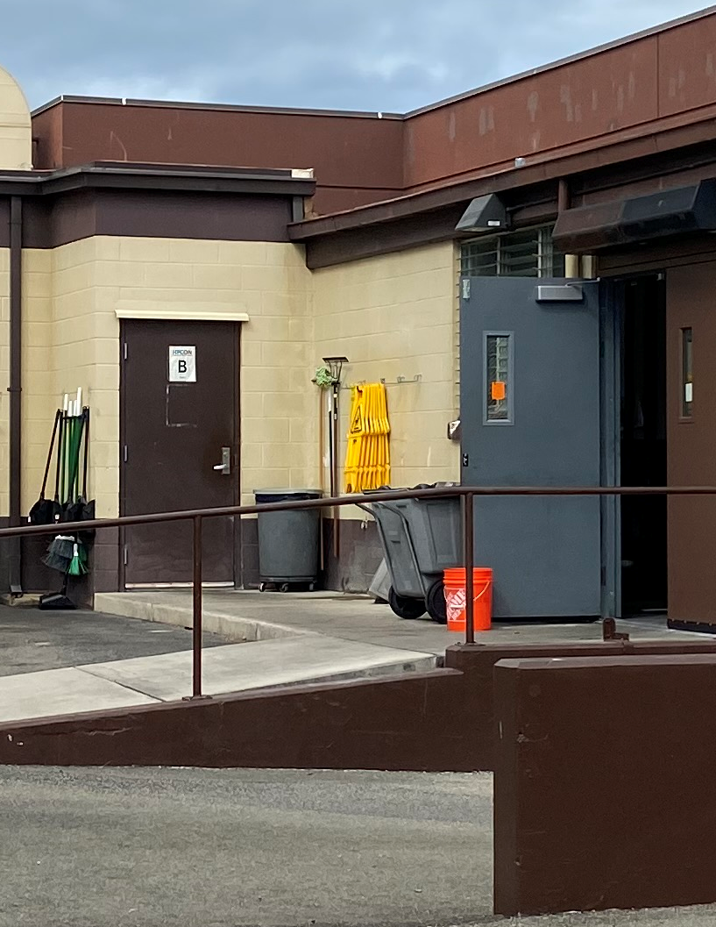
MEAL ORDERING PROCESS
ORDERS MUST BE PLACED BY CALLING 449-1666 OR ORDER AT THE FLIGHT KITCHEN ENTRANCE IN THE BACK OF THE HALE MOKU DFAC
FLIGHT KITCHEN MEALS ARE AVAILABLE 24/7
HOT MEALS ARE AVAILABLE DURING MEAL HOURS
  BREAKFAST 0600-0830
  LUNCH 1100-1300
  DINNER 1700-1830
MEALS ARE AVAILABLE FOR
PICK-UP AT THE FLIGHT KITCHEN (LOCATED IN THE BACK OF HALE MOKU DFAC, BLDG. 1860

Slide 2
FLIGHT KITCHEN MENU
ENTREES:
L1 Ham & Turkey Sub
L2 Turkey & Cheese Sub
L3 Ham & Cheese Sub
L4 Turkey & Bacon Croissant
L5 Ham & Cheese Croissant
L6 Buffalo Chicken Wrap
L7 Breaded Chicken Burger
L8 Breaded Chicken Tenders
L9 Chipotle Chicken Sandwich
L10 “Uncrustables” PB & J Sandwich
L11 Chef Salad
L12 Breakfast Cereal (2ea) w/ milk
Meal Card Personnel: NO CHARGE Cash Customer (Standard Rate): $6.00
THIS IS A 24-HOUR OPERATION
Select a Meal and Supplement Package (Example: L4/S2)
SUPPLEMENT PACKAGES:
*MENU SUBJECT TO CHANGE*
Supplement #1 Soda, Chips , Nutrigrain Bar, Apple or Orange
Supplement #2 Gatorade, Carrot/Celery Sticks w/Ranch Dressing Apple or Orange, Nutrigrain Bar
Supplement #3 Water, Hummus w/ Pretzel Chips, Apple or Orange, Granola Bar
Supplement #4 Orange Juice, Apple or Orange, Boiled Eggs (2), Nutrigrain Bar

Slide 3
RESTRICTION OF MOVEMENT
(ROM) PERSONNEL
STEP 1: POC WILL GATHER THE FOLLOWING INFORMATION FROM THE AFFECTED MEMBERS PRIOR TO PLACING ORDER
    RANK, NAME, DOD ID#, AND UNIT FOR EACH MEMBER NOT LISTED ON THE SIGNED CONSOLIDATED MEMO
    MEAL ORDER FROM FLIGHT KITCHEN OR DFAC HOT MEAL MENU’S
STEP 2: PLACE ORDER WITH DFAC
    CALL 449-1666 (RECOMMEND AT LEAST 2 HOUR CALL AHEAD FOR ORDERS OF 10 OR MORE)
    OR ORDER AT THE MOUKELELE PROVIDE SIGNED CONSOLIDATED MEMO AND RANK, NAME, DOD ID#, AND UNIT FOR MEMBERS NOT LISTED ON THE MEMO (prior to or upon arrival)
    STEP 3: PICK UP ORDER AT THE MOKULELE Flight Kitchen
STEP 4: DELIVER MEALS (Hale Moku/MOKULELE DFAC is not responsible for deliveries)
MEAL COST
ESM/RIK & BAS: NO CHARGE

Slide 4
TRANSIENT RESTRICTION OF MOVEMENT
(ROM) PERSONNEL
TRANSIENT ROM PERSONNEL ARE DEFINED AS: PERSONNEL IN ROM STATUS TRAVELING THROUGH JBPH-H AND RECEIVING PER DIEM
PERSONNEL STAYING AT AMC TERMINAL: WILL COORDINATE WITH AMC TERMINAL CUSTOMER SERVICE TO RECEIVE MEALS
PERSONNEL LEAVING AMC TERMINAL: TRANSIENT PERSONNEL POC IS REQUIRED TO COORDINATE MEAL ORDER, PAYMENT, PICK-UP, AND DELIVERY (STEPS BELOW)
STEP 1: POC WILL GATHER THE FOLLOWING INFORMATION FROM THE AFFECTED MEMBERS PRIOR TO PLACING ORDER
    PRINT ATTACHED AIR FORCE FORM 79
    DOCUMENT NAME AND RANK IN COLUMN A
    CONSOLIDATE MEAL ORDER FROM FLIGHT KITCHEN OR DFAC HOT MEAL MENUS (EX: 1-, 4-L1 meal /S3 supp )
STEP 2: PLACE ORDER WITH DFAC
    CALL 449-1666 (RECOMMEND AT LEAST 24 HOUR CALL AHEAD FOR ORDERS OF 10 OR MORE and 72 Hours for 100 or
    more )
    PROVIDE CONTACT INFORMATION, NUMBER/TYPE OF MEALS REQUIRED, REQUESTED PICK-UP TIME
    DFAC LEADERSHIP TEAM WILL CONTACT POC TO COORDINATE ADDITIONAL MEAL SUPPORT, IF NECESSARY
STEP 3: PICK UP ORDER AT THE MOKULELE FLIGHT KITCHEN PROVIDE COMPLETED AF FORM 79 AND TOTAL PAYMENT FOR ALL MEALS CASH ONLY
DUE TO RECEIVING PER DIEM, TRANSIENT ROM PERSONNEL ARE REQUIRED TO PAY
MEAL COST DETERMINED BY SELECTED MENU OPTION

